Slide 1
Lecture 4 – Binary Response Models
Yanwen Wang
Sauder School of Business
University of British Columbia
Feb-March 2018

Slide 2
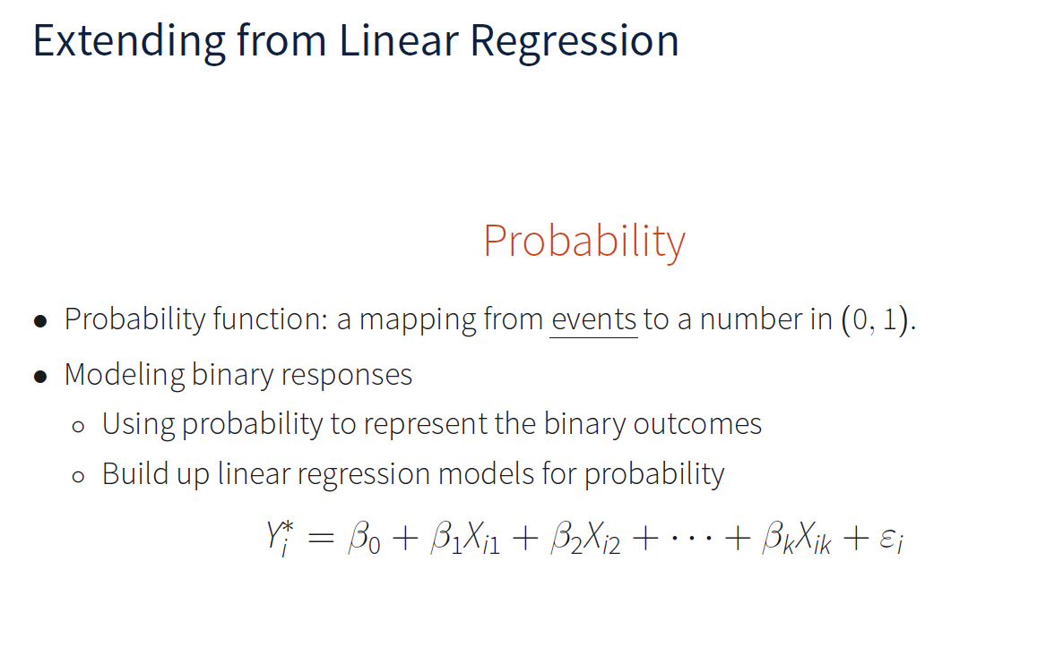

Slide 3
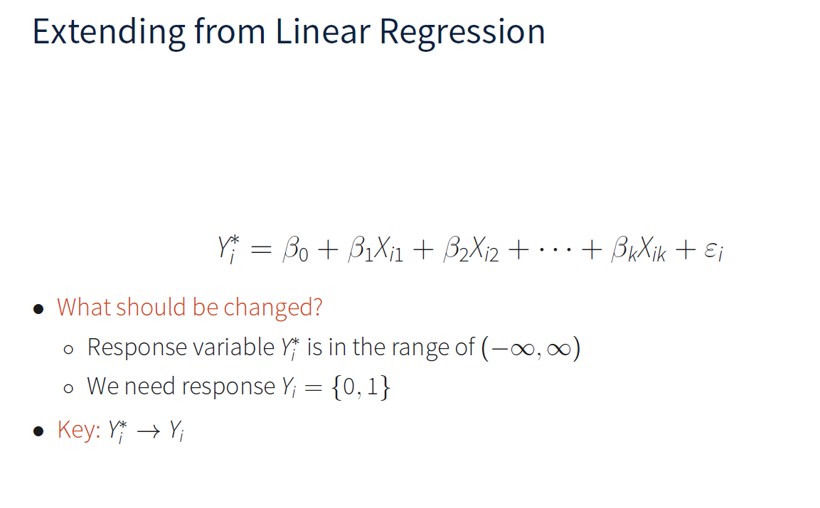

Slide 4
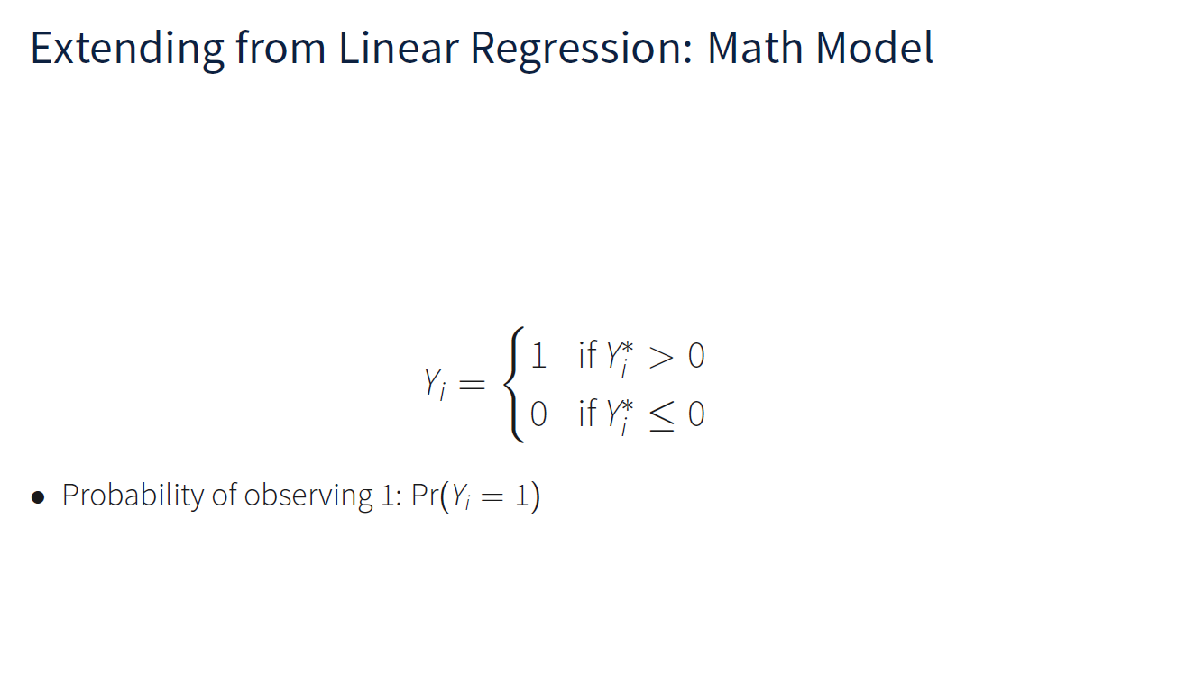

Slide 5
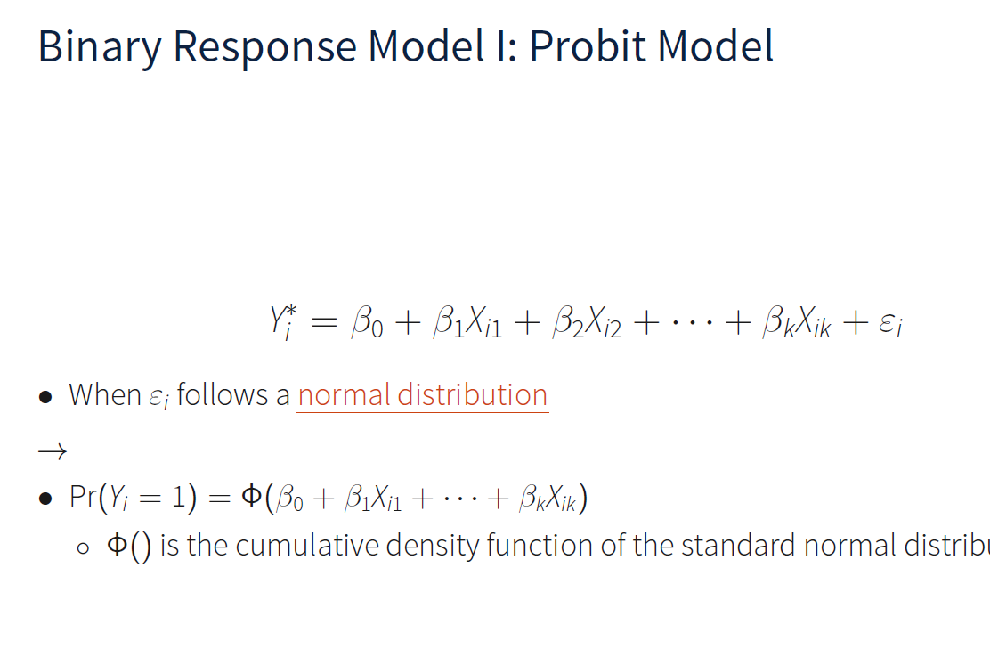

Slide 6
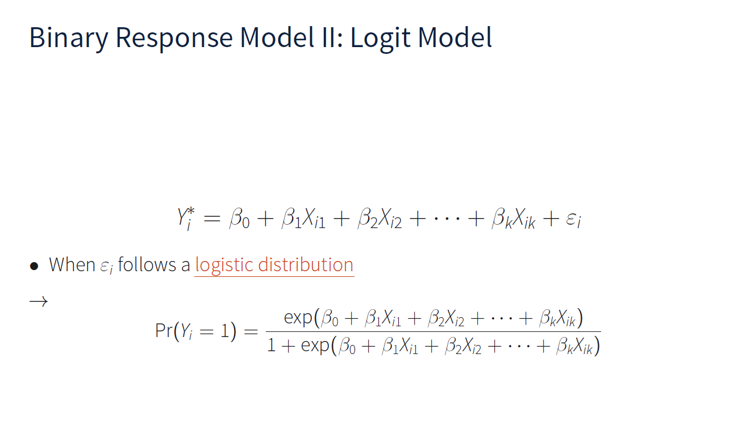

Slide 7
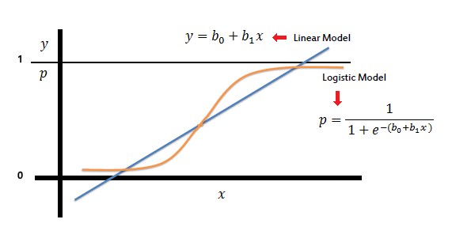
The linear vs. the logistic model

Slide 8
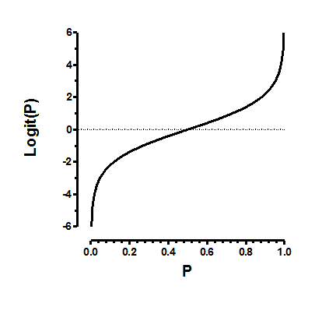
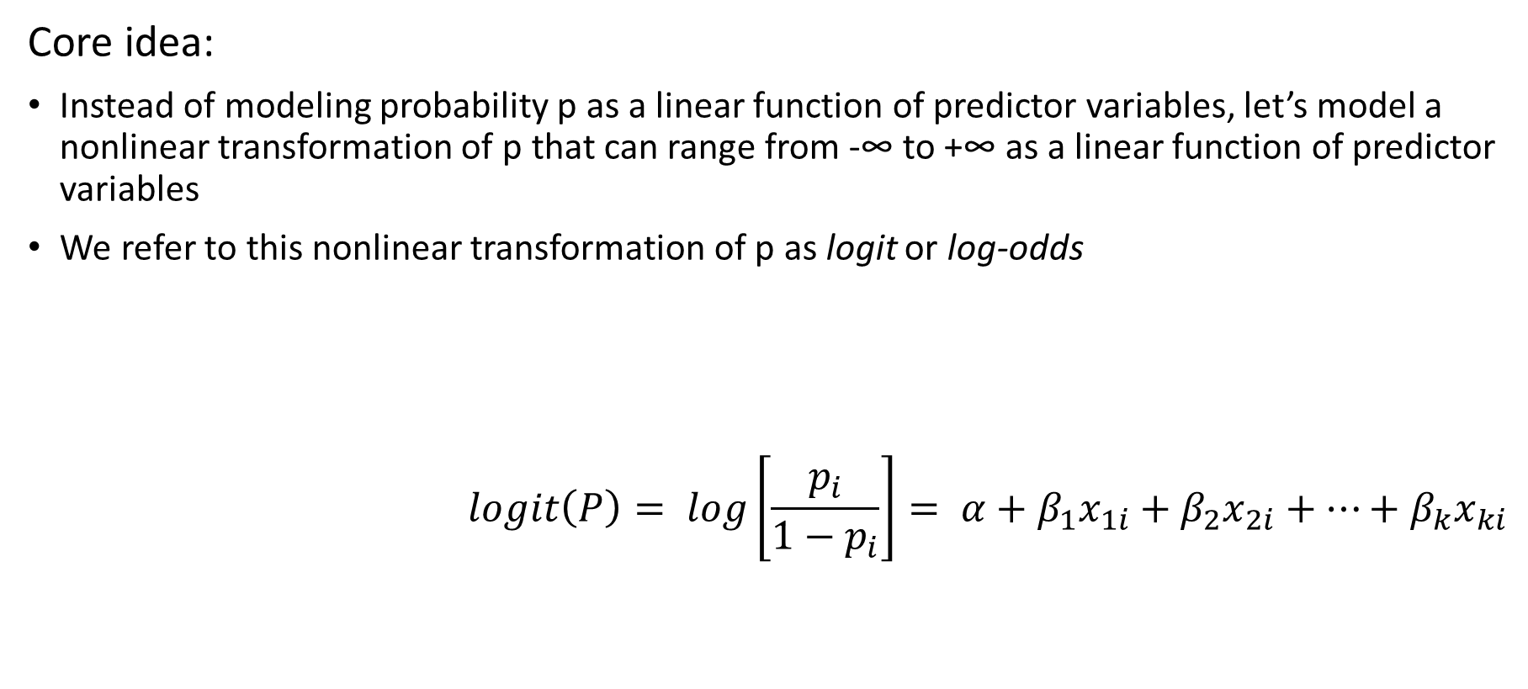
The logit model
Core idea:
Instead of modeling probability p as a linear function of predictor variables, let’s model a nonlinear transformation of p that can range from -∞ to +∞ as a linear function of predictor variables
We refer to this nonlinear transformation of p as logit or log-odds
$$logit\left(P\right)= log\left[\frac{p_{i}}{1−p_{i}}\right]= α+β_{1}x_{1i}+β_{2}x_{2i}+…+β_{k}x_{ki}$$
Notes:
p/(1-p)

Slide 9
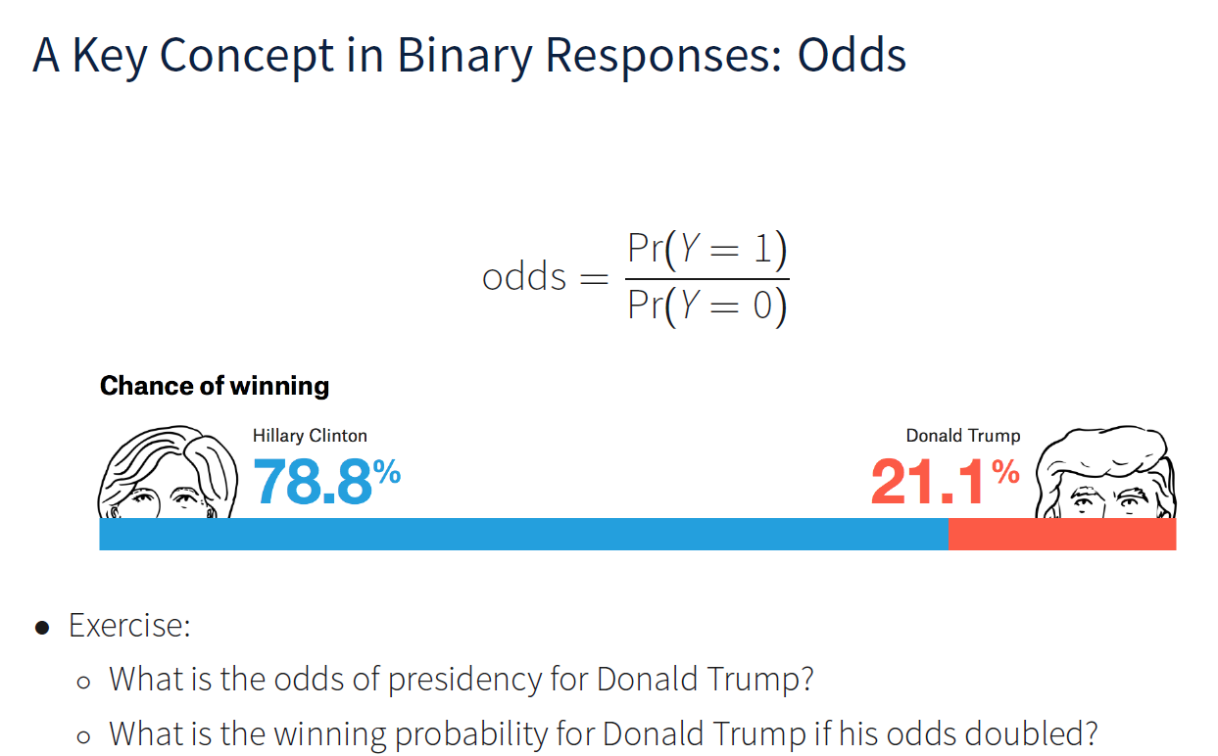

Slide 10
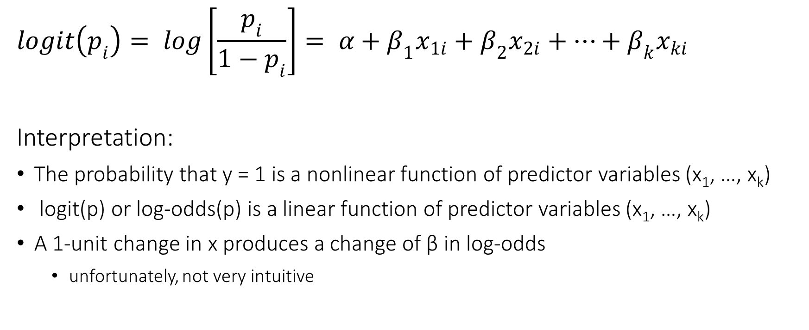
The logistic model
$$logit\left(p_{i}\right)= log\left[\frac{p_{i}}{1−p_{i}}\right]= α+β_{1}x_{1i}+β_{2}x_{2i}+…+β_{k}x_{ki}$$
Interpretation:
The probability that y = 1 is a nonlinear function of predictor variables (x₁, …, x_{k})
logit(p) or log-odds(p) is a linear function of predictor variables (x₁, …, x_{k})
A 1-unit change in x produces a change of β in log-odds
unfortunately, not very intuitive

Slide 11
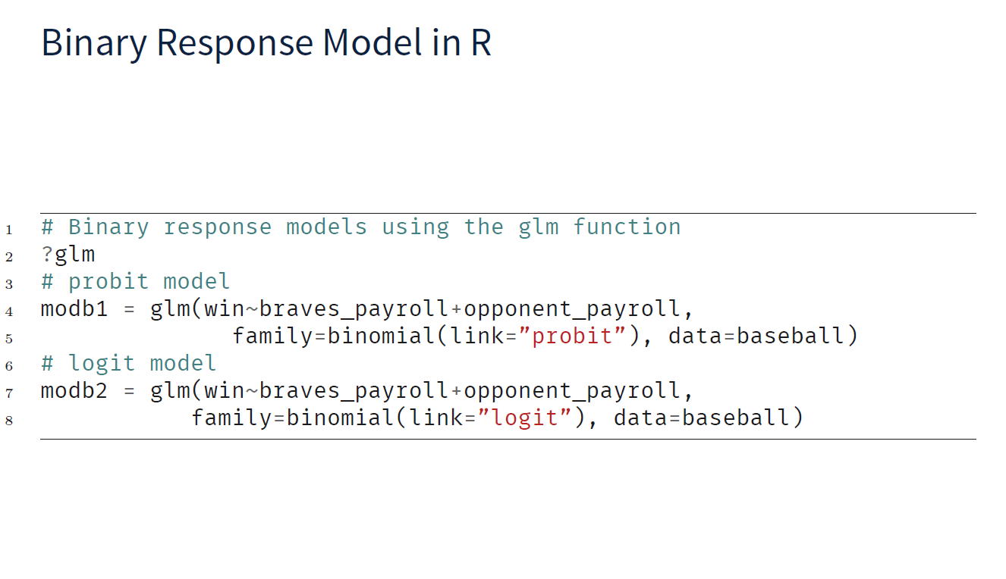

Slide 12
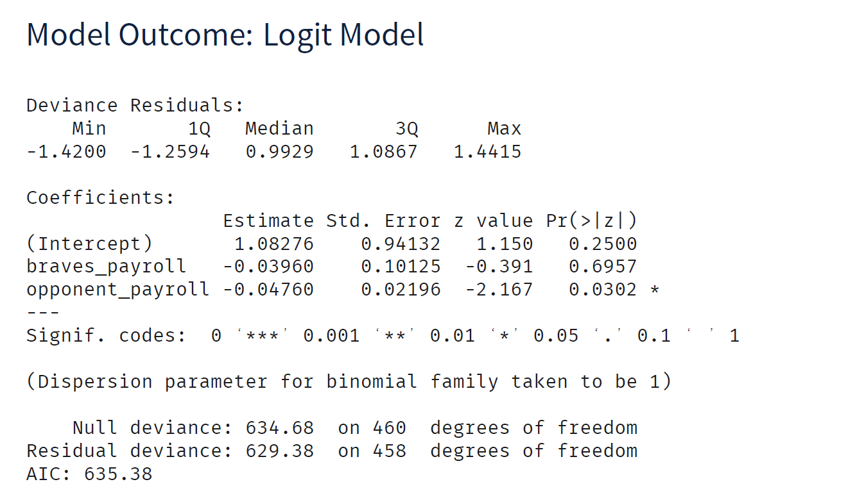

Slide 13
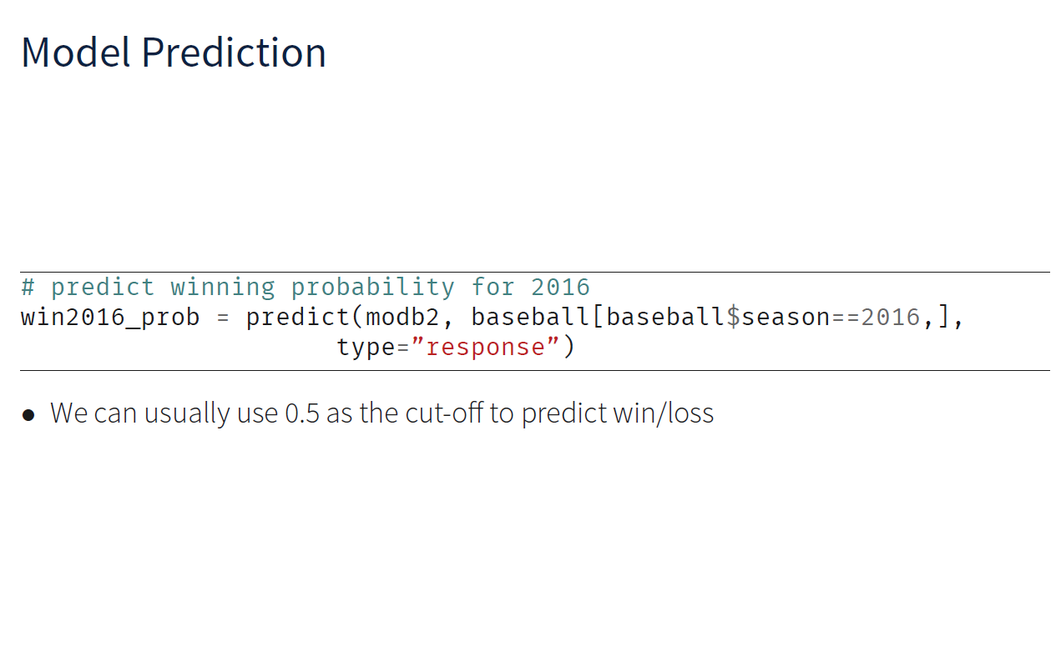
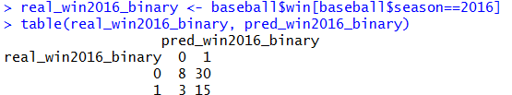

Slide 14
Response Model Hit Rate
Model Says:
Target
Don’t Target
HIT | MISS (Type II Error)
FALSE ALARM (Type I Error) | CORRECT REJECTION
Responded
Customer Would Have:
Not Responded
Notes:
How do we evaluate the value of a model? Spur class discussion. Is it enough to get a lot of hits? Why not?

Slide 15
A Challenge for the Logistic Regression Approach
How do we decide if our model is doing a good job?
Fit statistics are not very intuitive.
How do we get a sense of effect sizes of different independent variables?
Parameter estimates do not have intuitive interpretations.

Slide 16
Two Tools for Evaluating Response Models
Cumulative Lifts: How much of a bump in my response rate do I get by targeting fewer people?
see reference materials on the Connect under Lecture 4
Cumulative Gains: As I target more people how rapidly do I get most of the responders?
Gini Coefficient summary statistic
see reference materials on the Connect under Lecture 4

Slide 17
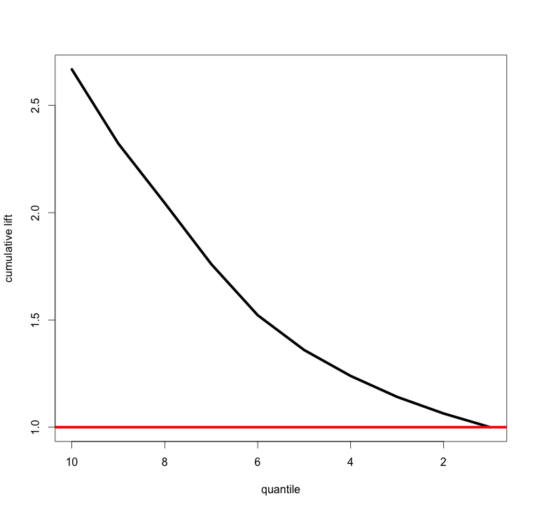
Cumulative Lift Chart
Notes:
The sharper the curve, the better the model. The more discrimination.
The red curve is equivalent to choosing people at random.
Usually, have a point of diminishing returns, though these data are relatively linear.

Slide 18
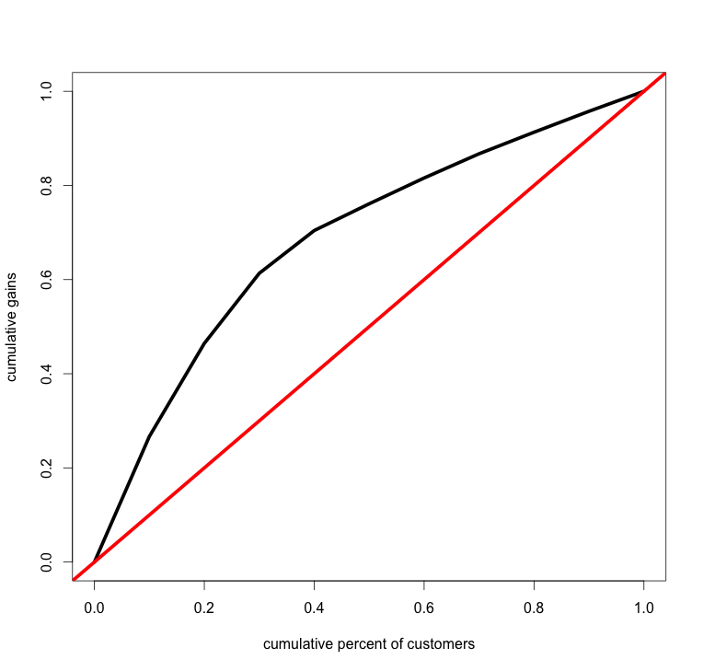
Cumulative Gain Chart (aka Banana Chart)
Notes:
The fatter the banana, the more discriminating the model.
Gini often used to describe income inequality

